Slide 1

Project Report Case of Death
Flip Robo technologies
Prepared by
Deepika
SME. Khushboo Garg

Slide 2
About Dataset
A straightforward way to assess the health status of a population is to focus on mortality – or concepts like child mortality or life expectancy, which are based on mortality estimates. A focus on mortality, however, does not take into account that the burden of diseases is not only that they kill people, but that they cause suffering to people who live with them. Assessing health outcomes by both mortality and morbidity (the prevalent diseases) provides a more encompassing view on health outcomes. This is the topic of this entry. The sum of mortality and morbidity is referred to as the ‘burden of disease’ and can be measured by a metric called ‘Disability Adjusted Life Years‘ (DALYs). DALYs are measuring lost health and are a standardized metric that allow for direct comparisons of disease burdens of different diseases across countries, between different populations, and over time. Conceptually, one DALY is the equivalent of losing one year in good health because of either premature death or disease or disability. One DALY represents one lost year of healthy life. The first ‘Global Burden of Disease’ (GBD) was GBD 1990 and the DALY metric was prominently featured in the World Bank’s 1993 World Development Report. Today it is published by both the researchers at the Institute of Health Metrics and Evaluation (IHME) and the ‘Disease Burden Unit’ at the World Health Organization (WHO), which was created in 1998. The IHME continues the work that was started in the early 1990s and publishes the Global Burden of Disease study.

Slide 3
Content
Dataset Glossary (Column-wise)
01. Country/Territory - Name of the Country/Territory
02. Code - Country/Territory Code
03. Year - Year of the Incident
04. Meningitis - No. of People died from Meningitis
05. Alzheimer's Disease and Other Dementias - No. of People died from Alzheimer's Disease and Other Dementias
06. Parkinson's Disease - No. of People died from Parkinson's Disease
07. Nutritional Deficiencies - No. of People died from Nutritional Deficiencies
08. Malaria - No. of People died from Malaria
09. Drowning - No. of People died from Drowning

Slide 4
10. Interpersonal Violence - No. of People died from Interpersonal Violence 11. Maternal Disorders - No. of People died from Maternal Disorders 12. Drug Use Disorders - No. of People died from Drug Use Disorders 13. Tuberculosis - No. of People died from Tuberculosis 14. Cardiovascular Diseases - No. of People died from Cardiovascular Diseases 15. Lower Respiratory Infections - No. of People died from Lower Respiratory Infections 16. Neonatal Disorders - No. of People died from Neonatal Disorders 17. Alcohol Use Disorders - No. of People died from Alcohol Use Disorders 18. Self-harm - No. of People died from Self-harm 19. Exposure to Forces of Nature - No. of People died from Exposure to Forces of Nature 20. Diarrheal Diseases - No. of People died from Diarrheal Diseases 21. Environmental Heat and Cold Exposure - No. of People died from Environmental Heat and Cold Exposure

Slide 5
22. Neoplasms - No. of People died from Neoplasms 23. Conflict and Terrorism - No. of People died from Conflict and Terrorism 24. Diabetes Mellitus - No. of People died from Diabetes Mellitus 25. Chronic Kidney Disease - No. of People died from Chronic Kidney Disease 26. Poisonings - No. of People died from Poisoning 27. Protein-Energy Malnutrition - No. of People died from Protein-Energy Malnutrition 28. Chronic Respiratory Diseases - No. of People died from Chronic Respiratory Diseases 29. Cirrhosis and Other Chronic Liver Diseases - No. of People died from Cirrhosis and Other Chronic Liver Diseases 30. Digestive Diseases - No. of People died from Digestive Diseases 31. Fire, Heat, and Hot Substances - No. of People died from Fire or Heat or any Hot Substances 32. Acute Hepatitis - No. of People died from Acute Hepatitis

Slide 6
Importing the libraries of the python Data Analysis :- We have use Jupiter Notebook and many libraries such as pandas ,Numpy for loaded data and fill the data for analysis Visualization part we use seaborn and matplotlib for plot chart and visualizes it.

Slide 7
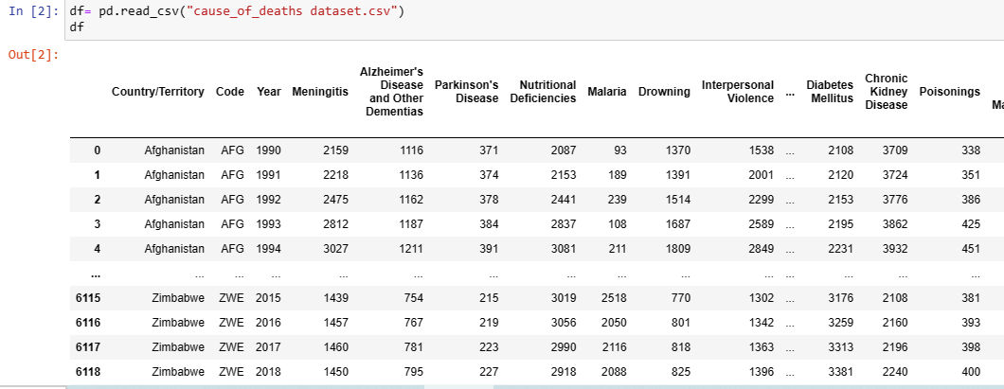
Data Analysis dataset

Slide 8
Data Analysis shape

Slide 9
Observation
There are total 6120 values and 34 columns in this data there are two columns are same country and code.

Slide 10
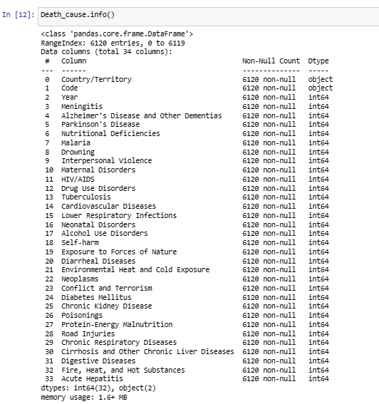
EDA:-
Checking the information of the dataset and count the column

Slide 11
Observation
Described here about the columns name null value ditypes of columns and memory usage. Here are two types data in dataset int64, only two columns are objective then other. we count of every column are equal so there are no nan present in dataset

Slide 12
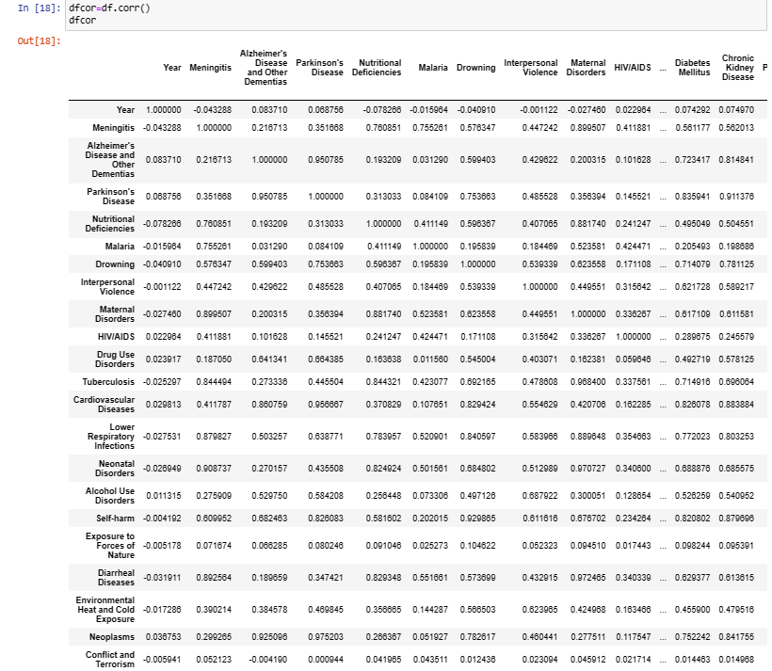
Describe the Dataset:-

Slide 13
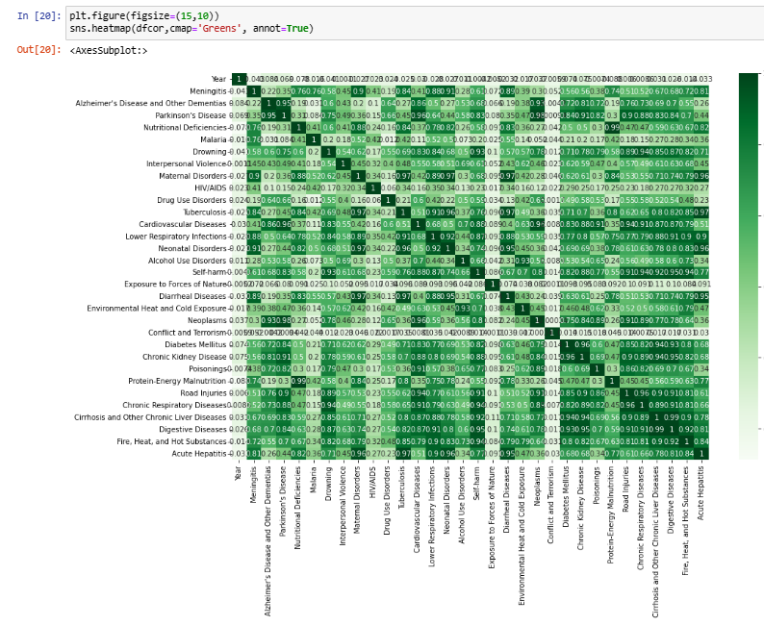
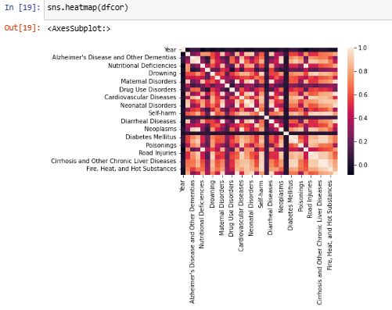

Slide 14
Observation:-
Here we have described the whole dataset by described command .
There count of all the columns that is 6120 which means no Null value is present in the dataset.
All the columns the Min and Max , and the Quartiles over here too
Here we can see the mean and standard deviation of all the Numeric columns in the dataset

Slide 15
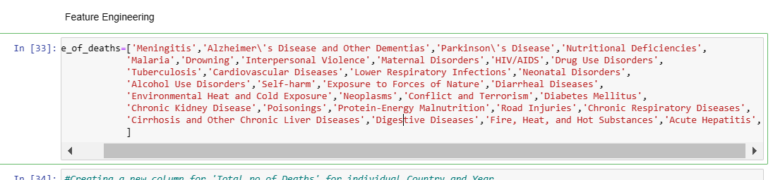
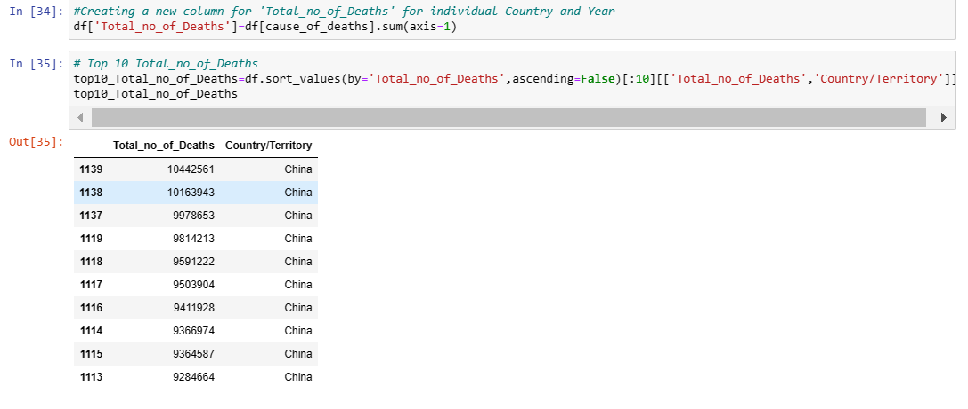
Feature Engineering:-

Slide 16
Observation:-
From the Above table, the "top 10-Total_no_of_Deaths" belongs to 'China' and the "top60-Total_no_of_Deaths" belongs to 'China' and 'India' combined, followed by 'USA' and 'RUSSIA'. This because of the fact "China" and "India" are the countries that stand in top 2 in terms of population

Slide 17
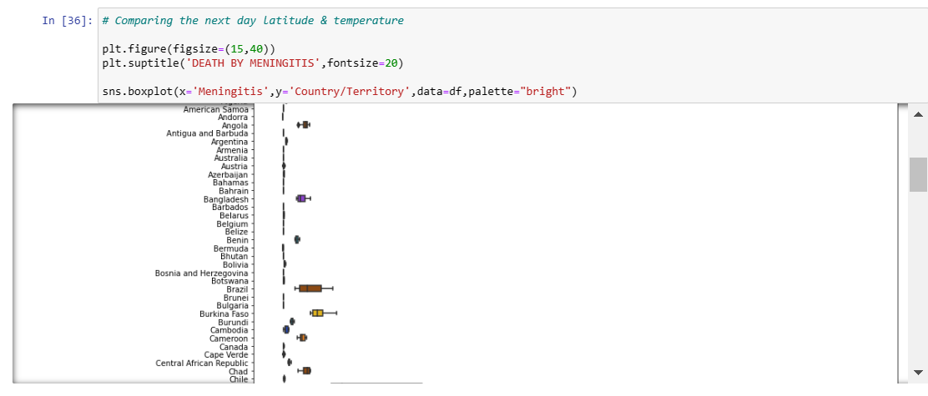
Visulation :-

Slide 18
Observation:-
Here i have tried doing Univariate Analysis of Meningitis column and Country columns but here we can see that it now clearly visible but we will try it in other Way .. Little conclusion we can derive from it is there are many country which are

Slide 19
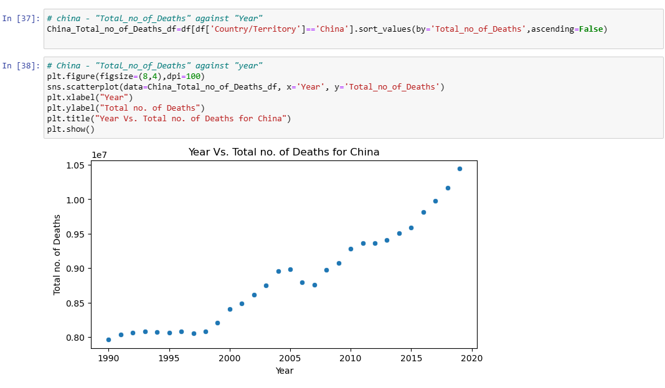
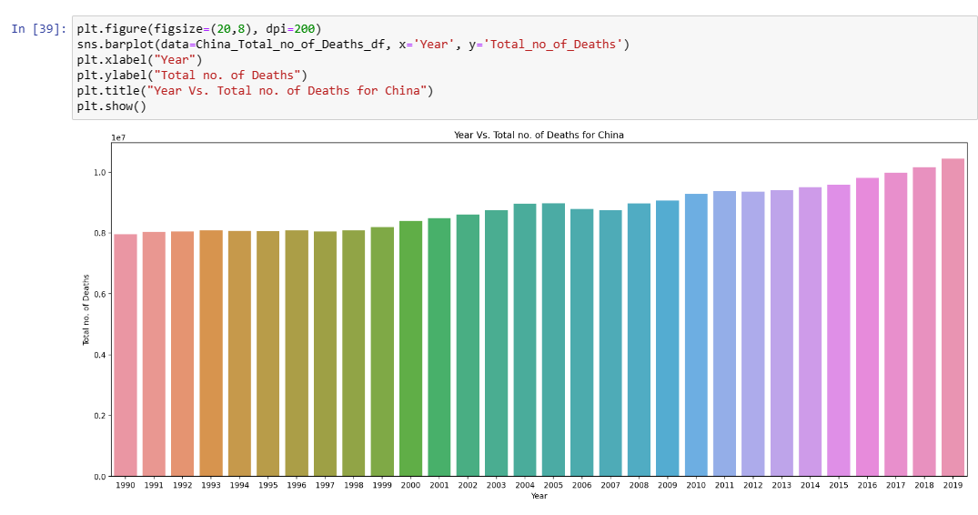
Visualization :- two top population country cause of China
we can see is a clear raise in Total No. of Deaths recorded with each year for China

Slide 20
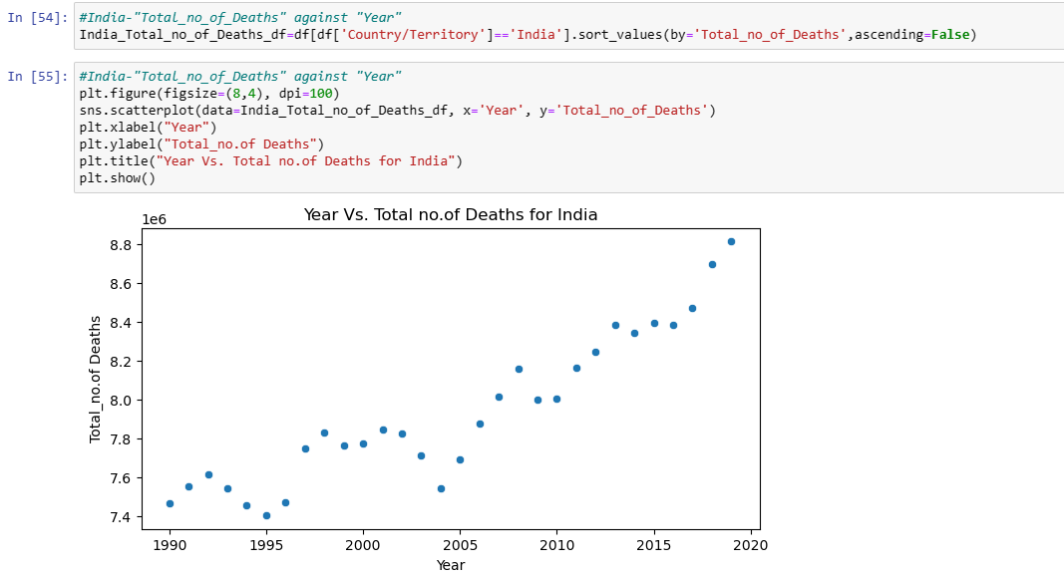
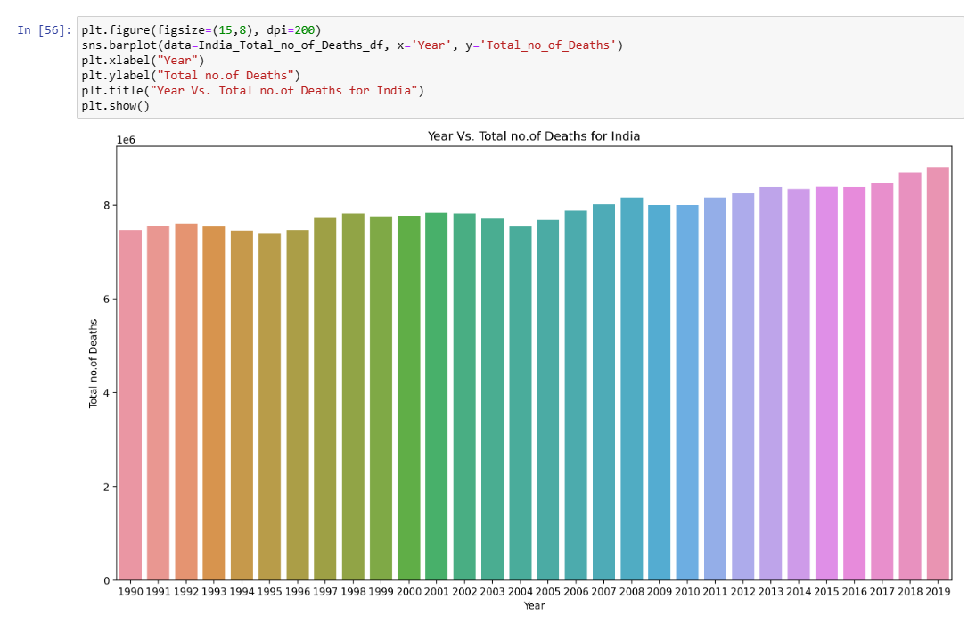
Visualization :- two top population country cause of India
Overall there is a raise in Total No. of Deaths recorded with each year for India, even though there are fluctuations in between

Slide 21
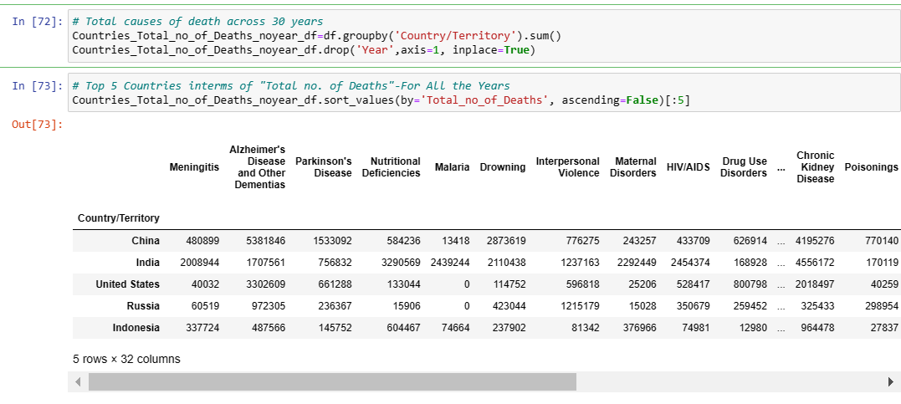
Total Cause of Death across 30 year:- (top 5 country )

Slide 22
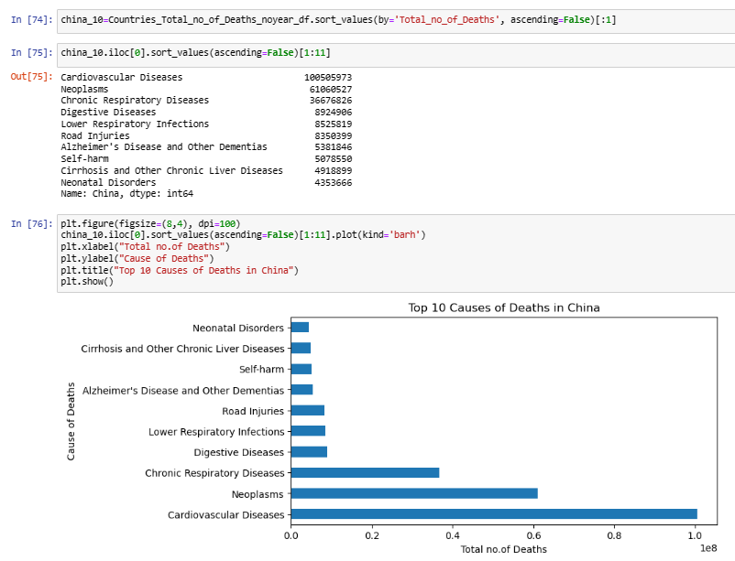
China-Top 10 Causes of Deaths:-

Slide 23
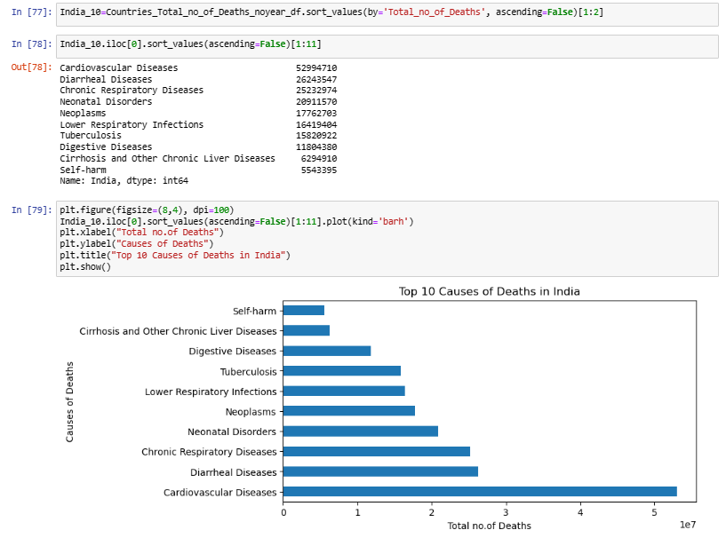
India-Top 10 Causes of Deaths:-

Slide 24
Thank You

